Slide 1

FORCE MODELING FOR OBLIQUE CUTTING ON NON-PLANAR SURFACES
Department of Mechanical Engineering
Dual degree project review meeting
19-10-2016
Submitted By: Ayush Bandil Guide: Prof. Anirban Guha & Prof. Asim Tewari

Slide 2

Ref: http://images.fineartamerica.com/images-medium-large/tray-table-on-an-airplane-jaak-nilson.jpg

Slide 3
INTRODUCTION
Extremely tight tolerance limit is required in Industries like aerospace and automotive
Limitations of conventional 3-axis milling processes:
Tolerance limit: High forces
Tool wear: Quality
Tool accessibility: free form surfaces
Lead and tilt

Slide 4
Normal
Feed
tilt
lead
Cross feed

Slide 5
PROJECT OBJECTIVE AND MOTIVATION
Motivation:
Analytical empirical and numerical models exist for
Limited geometries: mainly ball-end
Workpiece material: Titanium alloy Ti₆Al₄V
Planer geometries: not edges and corners
Overall aim: To develop a general methodology to predict the cutting forces during the 5-axis milling process
Phase 1 objective: Model for ball end cutting tool with helical cutting edge operating on planer geometries in one direction

Slide 6
LITERATURE REVIEW

Slide 7
Many researchers have worked on milling processes across the world:
P. Lee and Y. Altintas, 1995, “PREDICTION OF BALL-END MILLING FORCES FROM ORTHOGONAL CUTTING DATA”: Basic analytical model with helical ball-end mills
L. Xu , J. K. Schueller & J. Tlusty, 1998, “A simplified solution for the depth of cut in multi-path ball end milling”: Path increment angle in 3-axis milling which is analogous to the tilt angle
Lazoglu, Koc university, Turkey in 2003: completely experimental on boring process
E. Ozturk and E. Budak, 2007, Istanbul, Turkey published “MODELING OF 5-AXIS MILLING PROCESSES”: dealt with complete
Binglin Li , Yujin Hu, Chenggang Li & Xingxing Li, China, 2011 “AN ANALYTICAL MODEL OF OBLIQUE CUTTING WITH APPLICATION TO END MILLING”: conversion of orthogonal cutting parameters to oblique cutting

Slide 8
GEOMETRICAL MODELLING OF BALL-END MILL
Step 1
Establishing coordinate systems for cutting tool as well as workpiece
Mathematical formulation of tool geometry
Step 3
Defining cutting edge parameters
Step 4
Discretization of surface and
Step 5
Identification of engagement region (cutting zone)
Step 6
Step 2
Step 7
Step 8
Computation of elemental forces and torques
Transformation of forces and torques to TCS and then FCN
Determining chip dimensions
Determining edge and cutting force coefficients
Step 9

Slide 9
Normal
z
Feed
y
tangential
radial
axial
Cross feed
x

Slide 10
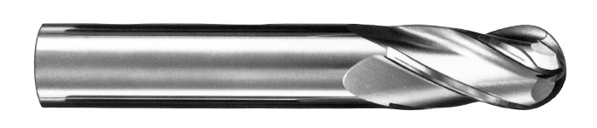
Ref: http://www.sgstool.com/images-dev/_products/series-1b.jpg

Slide 11
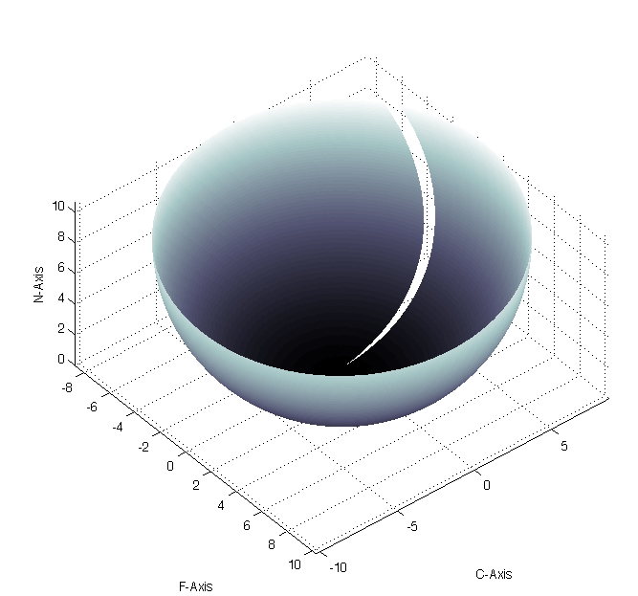
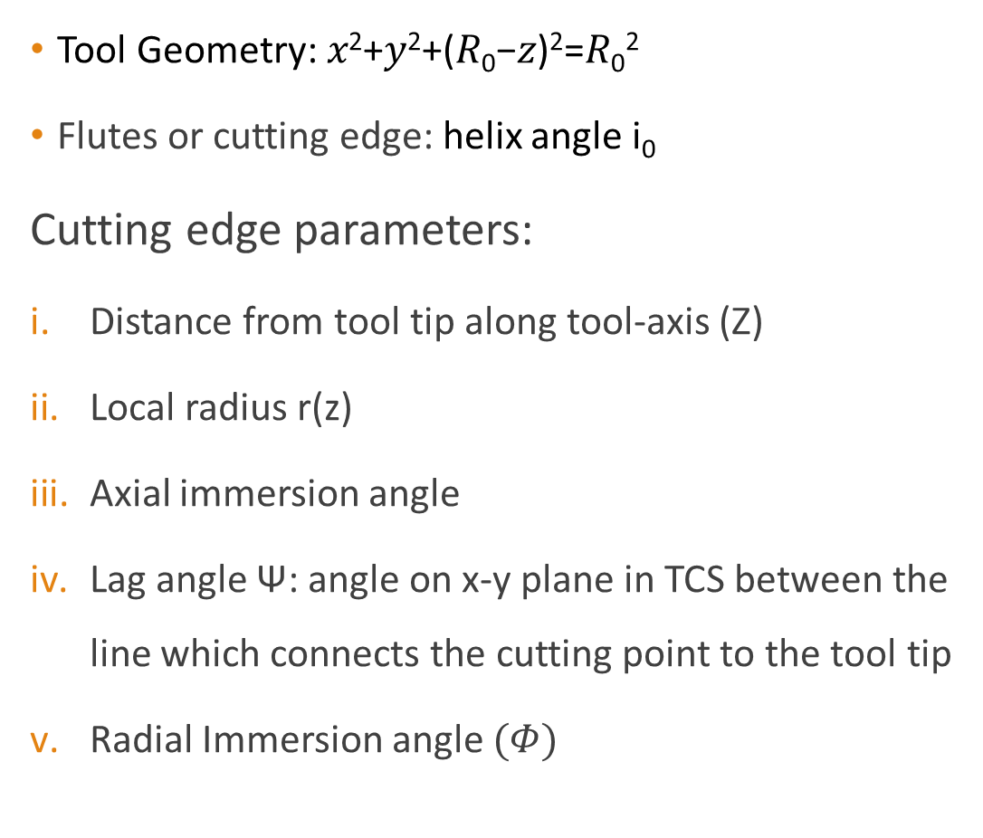
STEP 2 & 3: TOOL AND CUTTING EDGE GEOMETRIC PARAMETERS
Tool Geometry: 𝑥²+𝑦²+(𝑅₀−𝑧)²=𝑅₀²
Flutes or cutting edge: helix angle i₀
Cutting edge parameters:
Distance from tool tip along tool-axis (Z)
Local radius r(z)
Axial immersion angle
Lag angle Ψ: angle on x-y plane in TCS between the line which connects the cutting point to the tool tip
Radial Immersion angle $(Φ)$
Helical cutting edges on ball end mill envelope

Slide 12
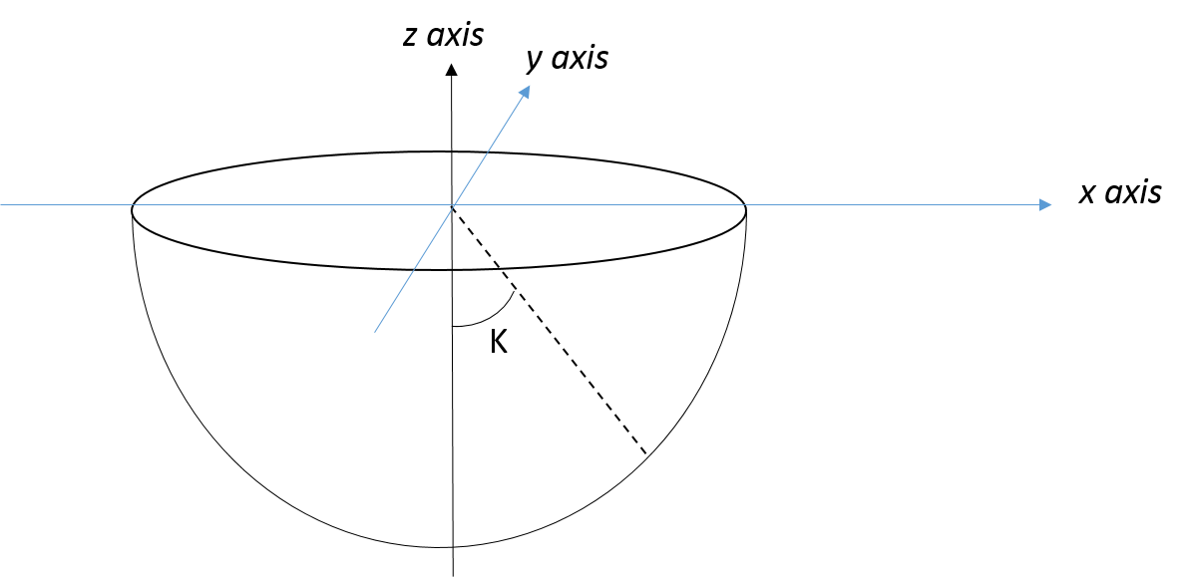
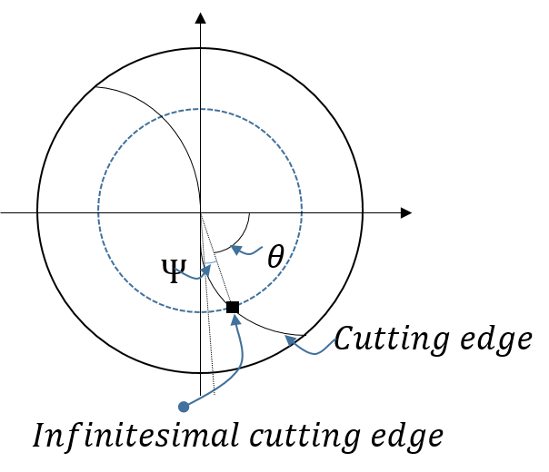
STEP 2 & 3: TOOL AND CUTTING EDGE GEOMETRIC PARAMETERS
r(z)
Helical cutting edges on ball end mill envelope

Slide 13
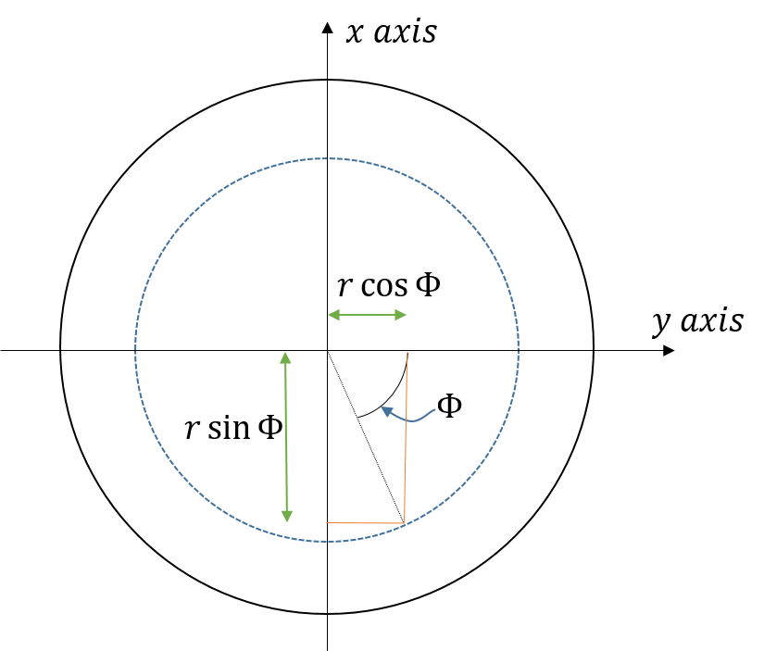
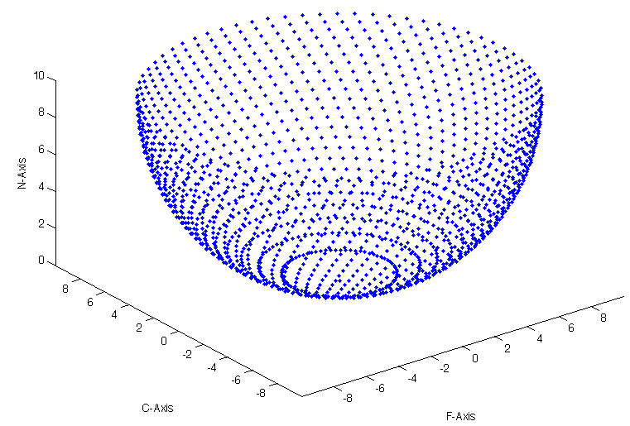
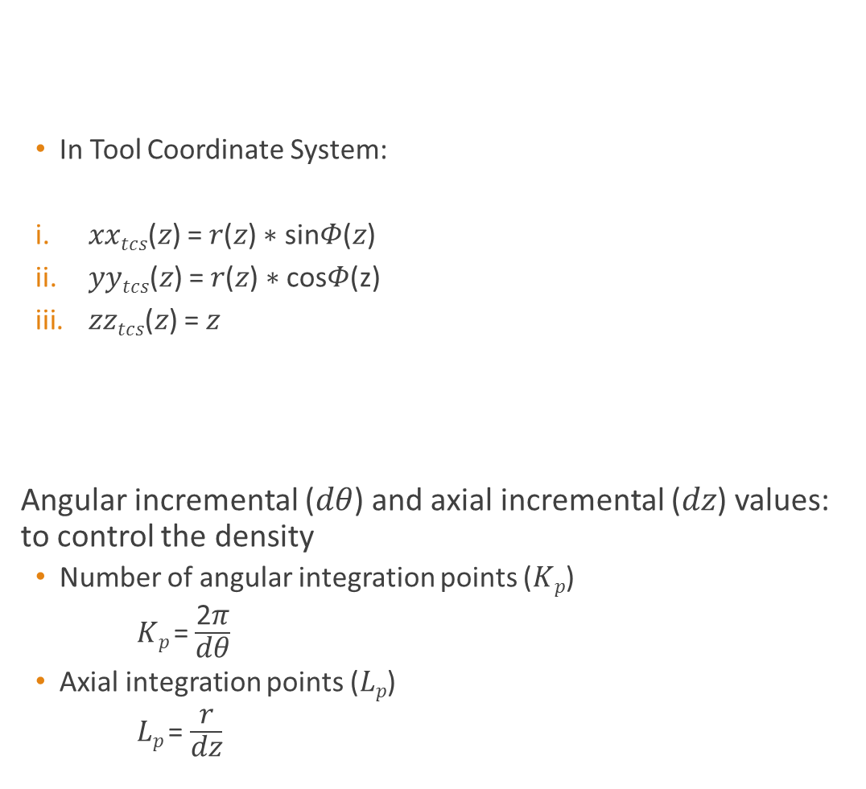
STEP 4: DISCRETIZATION OF SURFACE
In Tool Coordinate System:
𝑥𝑥_{𝑡𝑐𝑠}(𝑧) = 𝑟(𝑧) ∗ sin𝛷(𝑧)
𝑦𝑦_{𝑡𝑐𝑠}(𝑧) = 𝑟(𝑧) ∗ cos𝛷(z)
𝑧𝑧_{𝑡𝑐𝑠}(𝑧) = 𝑧
Angular incremental (𝑑𝜃) and axial incremental (𝑑𝑧) values: to control the density
Number of angular integration points (𝐾_{𝑝})
𝐾_{𝑝} = $\frac{\text{2}\text{π}}{\text{d}\text{θ}}$
Axial integration points (𝐿_{𝑝})
𝐿_{𝑝} = $\frac{\text{r}}{\text{dz}}$
Discretized points in FCN coordinate system envelope

Slide 14
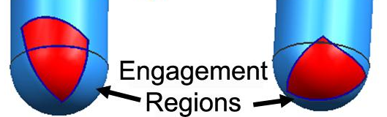
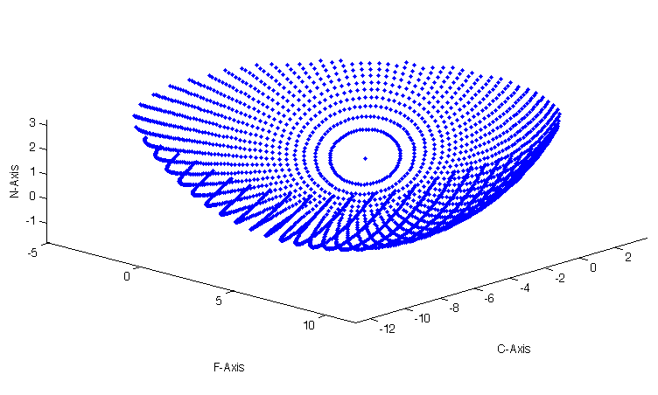
STEP 5: IDENTIFICATION OF CUTTING ZONE
Discretized points in FCN coordinate system envelope

Slide 15
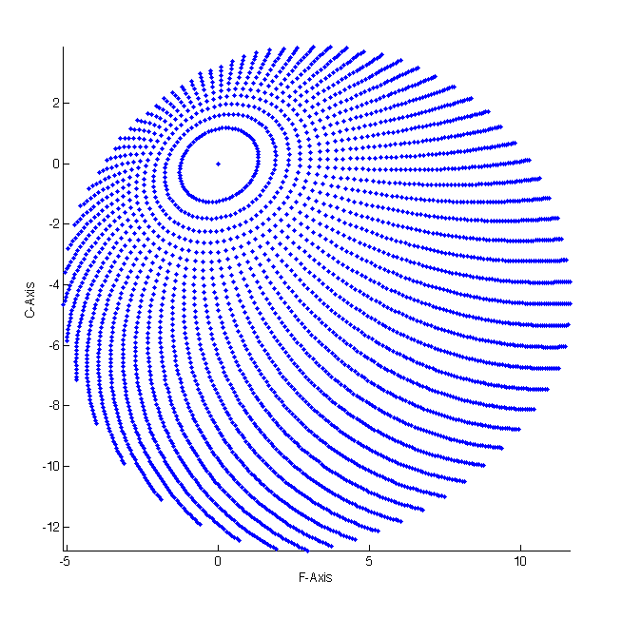
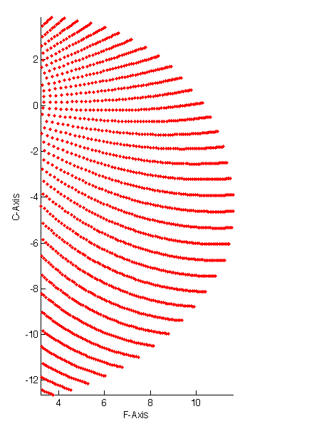

STEP 5: IDENTIFICATION OF CUTTING ZONE
Identified by removing two sets of points from the set of cutting points:
Points above the cutting depth
Points lying opposite to the direction of the feed in FCN coordinate system
$$P\left(i,j\right)==\left( z\left(i,j\right)>cutting depth\right) \&\& (\vec{feed}.\vec{OX}(j,i))$$
Logical Matrix (LG)
Discretized points in FCN coordinate system envelope
Top view of discretized points below the cutting depth
for 20⁰ lead 30⁰ tilt
Top view of discretized points in the cutting zone
for 20⁰ lead 30⁰ tilt

Slide 16
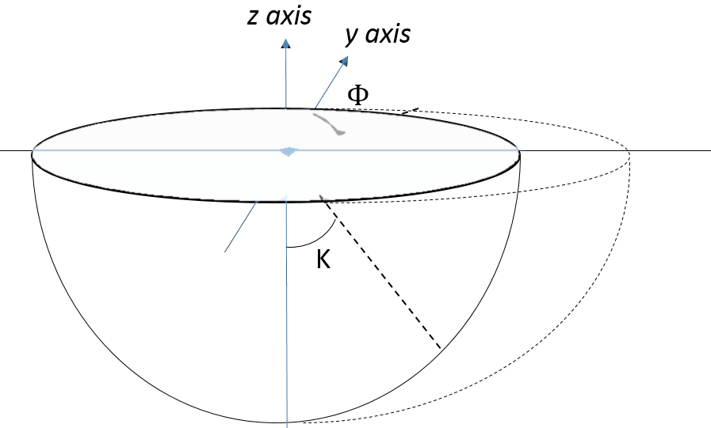
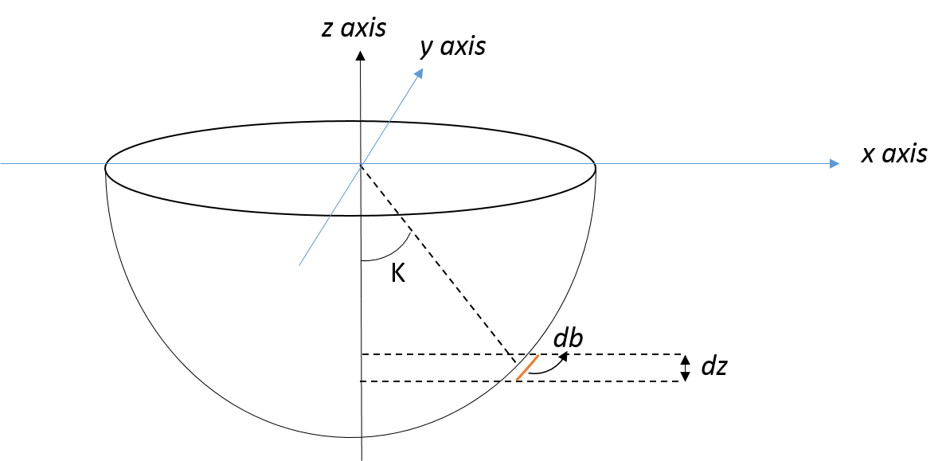
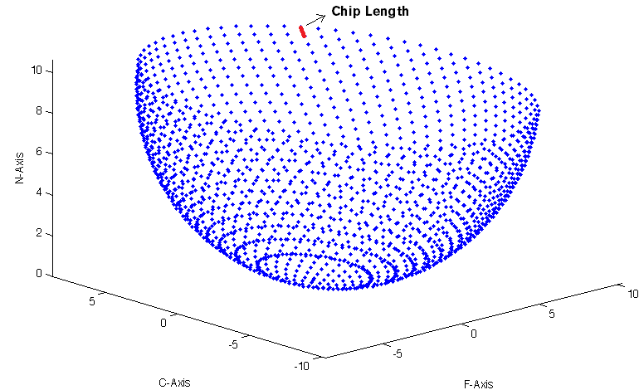

STEP 6: CHIP DIMESIONS
The forces generated depend on the geometry on the chips formed.
There are three geometric parameters which are as follows:
Chip thickness: $t_{n}(S_{t},Φ,K)=S_{t}\sin{Φ}\sin{K}$
Chip width: projected length of an element in the direction of cutting velocity: $db=\frac{dz}{\sin{K}}$
Chip length: distance between two adjacent cutting points: $ds=\sqrt{{(\vec{X}\left(j,i\right)−\vec{X}(j−1,i))}^{2}}$

Slide 17
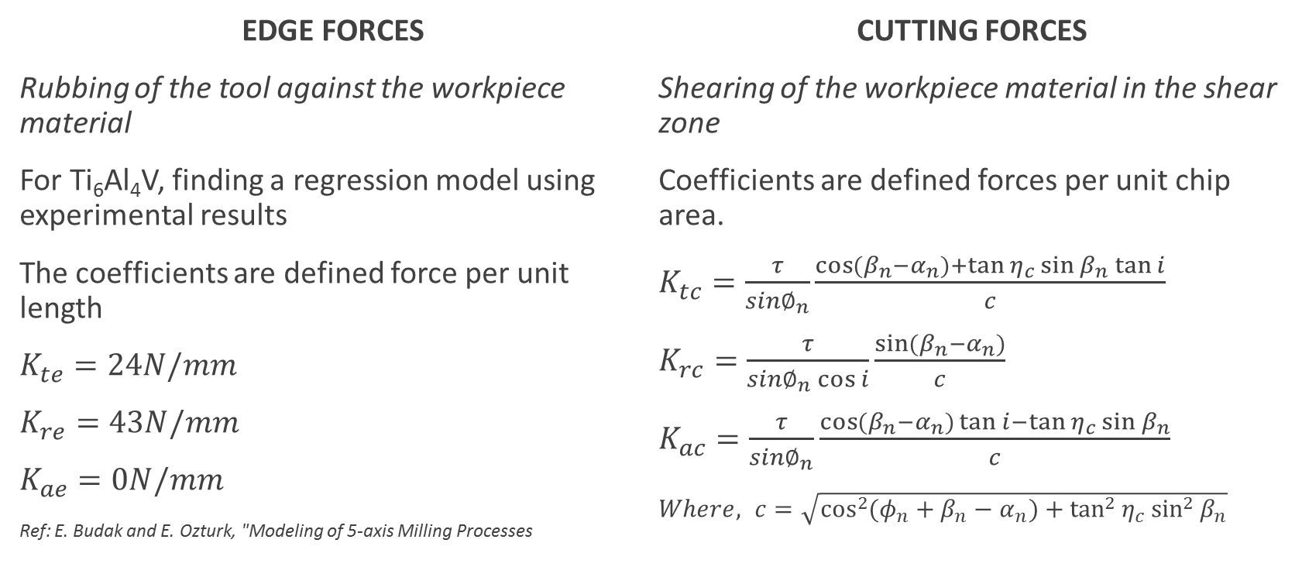
STEP 7: EDGE AND CUTTING FORCE COEFFICIENTS
EDGE FORCES
Rubbing of the tool against the workpiece material
For Ti₆Al₄V, finding a regression model using experimental results
The coefficients are defined force per unit length
$K_{te}=24N/mm$
$K_{re}=43N/mm$
$K_{ae}=0N/mm$
Ref: E. Budak and E. Ozturk, "Modeling of 5-axis Milling Processes
CUTTING FORCES
Shearing of the workpiece material in the shear zone
Coefficients are defined forces per unit chip area.
$K_{tc}=\frac{τ}{sin∅_{n}}\frac{\cos{(β_{n}−α_{n})}+\tan{η_{c}}\sin{β_{n}}\tan{i}}{c}$
$K_{rc}=\frac{τ}{sin∅_{n}\cos{i}}\frac{\sin{(β_{n}−α_{n})}}{c}$
$K_{ac}=\frac{τ}{sin∅_{n}}\frac{\cos{(β_{n}−α_{n})}\tan{i}−\tan{η_{c}}\sin{β_{n}}}{c}$
$Where, c=\sqrt{\cos^{2}{({φ_{n}+β}_{n}−α_{n})}+\tan^{2}{η_{c}}\sin^{2}{β_{n}}}$

Slide 18
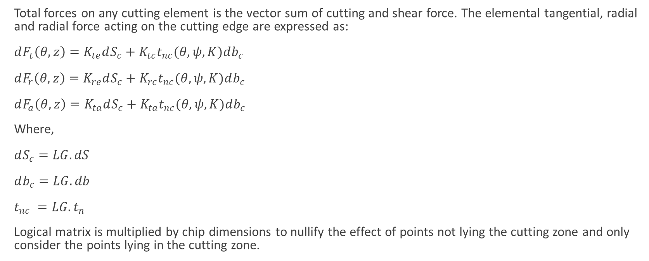
STEP 8: ELEMENTAL FORCES AND TORQUE
Total forces on any cutting element is the vector sum of cutting and shear force. The elemental tangential, radial and radial force acting on the cutting edge are expressed as:
$dF_{t}\left(θ,z\right)=K_{te}dS_{c}+K_{tc}t_{nc}(θ,ψ,K)db_{c}$
$dF_{r}\left(θ,z\right)=K_{re}dS_{c}+K_{rc}t_{nc}(θ,ψ,K)db_{c}$
$dF_{a}\left(θ,z\right)=K_{ta}dS_{c}+K_{ta}t_{nc}(θ,ψ,K)db_{c}$
Where,
$dS_{c}=LG.dS$
$db_{c}=LG.db$
$t_{nc} =LG.t_{n}$
Logical matrix is multiplied by chip dimensions to nullify the effect of points not lying the cutting zone and only consider the points lying in the cutting zone.

Slide 19

STEP 9: FORCE CALCULATION IN TCS and FCN
${\left\{\begin{matrix}dF_{x} \\ dF_{y} \\ dF_{z}\end{matrix}\right\}}_{TCS}=\left[A\right]{\left\{\begin{matrix}dF_{t} \\ dF_{r} \\ dF_{a}\end{matrix}\right\}}_{LCS}$
Where,
$\left[A\right]=\left[\begin{matrix}−\sin{K}\sin{φ} & −cos{φ} & −\cos{K}\sin{φ} \\ −\sin{K}\cos{φ} & −\sin{φ} & −\cos{K}\cos{φ} \\ \cos{K} & 0 & −\sin{K}\end{matrix}\right]$
Elemental Torque:
$dT_{TCS}=r\left(z\right).dF_{t}$

Slide 20
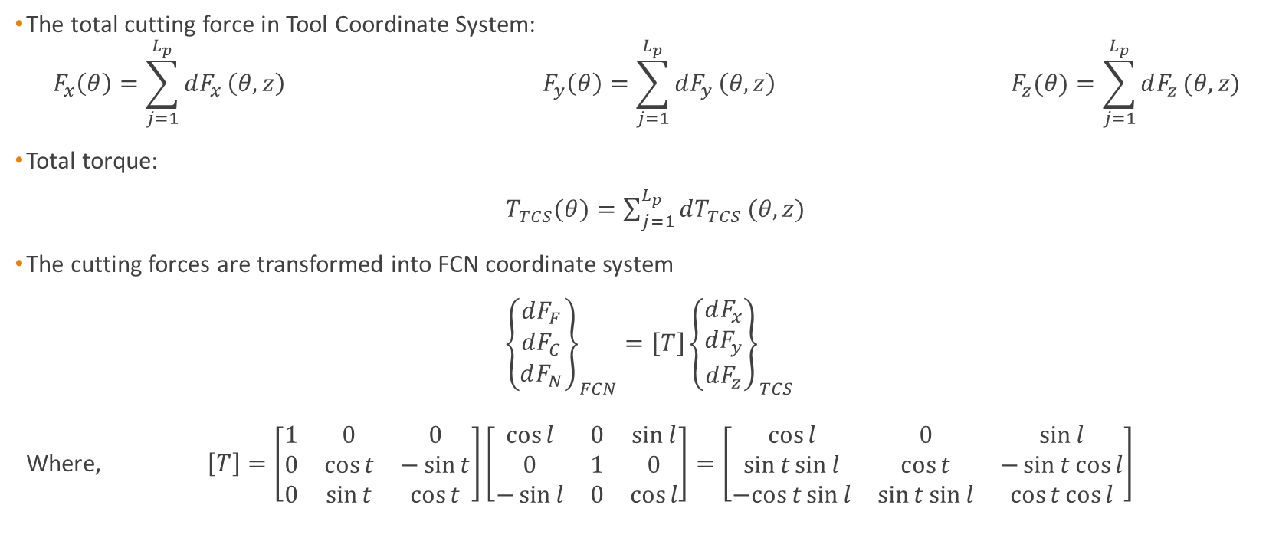
STEP 9: FORCE CALCULATION IN TCS and FCN
The total cutting force in Tool Coordinate System:
$$F_{x}\left(θ\right)=\sum_{j=1}^{L_{p}}{dF_{x}}\left(θ,z\right) F_{y}\left(θ\right)=\sum_{j=1}^{L_{p}}{dF_{y}}\left(θ,z\right) F_{z}(θ)=\sum_{j=1}^{L_{p}}{dF_{z}}(θ,z)$$
Total torque:
$T_{TCS}(θ)=\sum_{j=1}^{L_{p}}{dT_{TCS}}(θ,z)$
The cutting forces are transformed into FCN coordinate system
${\left\{\begin{matrix}dF_{F} \\ dF_{C} \\ dF_{N}\end{matrix}\right\}}_{FCN}=\left[T\right]{\left\{\begin{matrix}dF_{x} \\ dF_{y} \\ dF_{z}\end{matrix}\right\}}_{TCS}$
Where, $\left[T\right]=\left[\begin{matrix}1 & 0 & 0 \\ 0 & \cos{t} & −\sin{t} \\ 0 & \sin{t} & \cos{t}\end{matrix}\right]\left[\begin{matrix}\cos{l} & 0 & \sin{l} \\ 0 & 1 & 0 \\ −\sin{l} & 0 & \cos{l}\end{matrix}\right]=\left[\begin{matrix}\cos{l} & 0 & \sin{l} \\ \sin{t}\sin{l} & \cos{t} & −\sin{t}\cos{l} \\ −cos{t}\sin{l} & \sin{t}\sin{l} & \cos{t}\cos{l}\end{matrix}\right]$

Slide 21
RESULTS AND VALIDATION

Slide 22

CASE 1: Inputs parameters: Diameter, D = 19.05mm Helix angle, i₀ = 30⁰ Rake angle, $α$ = 0⁰ Number of flukes, N_{f} = 1 Spindle speed, n=269 rpm Table feed, S_{t} = 13.6652 mm/min Depth of cut = 6.35mm Lead angle = 0⁰ Tilt angle = 0⁰
1 cutting edge
Variation of F, C and N forces with rotational angle
As the cutting edge starts coming out of the cutting region all the three components start tending to zero.
Ref: P. Lee and Y. Altintas, “Prediction of ball end milling forces of orthogonal cutting data”

Slide 23
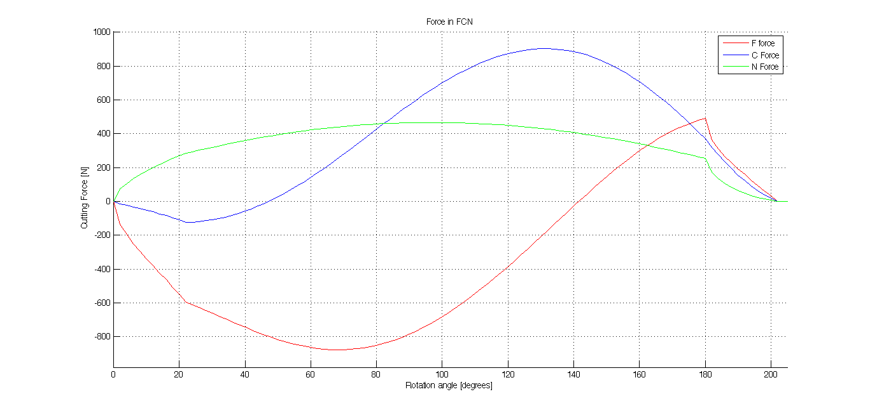
CASE 1: Inputs parameters: Diameter, D = 19.05mm Helix angle, i₀ = 30⁰ Rake angle, $α$ = 0⁰ Number of flukes, N_{f} = 1 Spindle speed, n=269 rpm Table feed, S_{t} = 13.6652 mm/min Depth of cut = 6.35mm Lead angle = 0⁰ Tilt angle = 0⁰
In this case, the ball-end tool has only 1 cutting edge.
Variation of F C and N forces with rotational angle
As the cutting edge starts coming out of the cutting region all the three components start tending to zero.

Slide 24
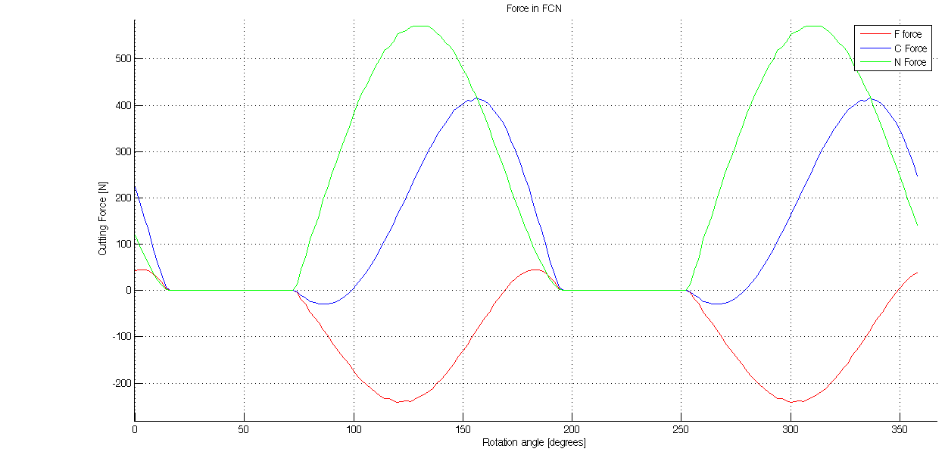

CASE 2: Inputs parameters: Diameter, D = 19.05mm Helix angle, i₀ = 30⁰ Rake angle, $α$ = 0⁰ Number of flukes, N_{f} = 2 Spindle speed, n=500 rpm Table feed, S_{t} = 100 mm/min Depth of cut = 6.35mm Lead angle = 30⁰ Tilt angle = 30⁰
lead and tilt angels are not zero, i.e. one of the cutting edge is already in the cutting zone and hence forces and torque do not start from zero.
Ref: E. Ozturk and E. Budak, “Modeling of 5-axis milling Processes, machining science and Technology”

Slide 25

CASE 3: Inputs parameters: Diameter, D = 20mm Helix angle, i₀ = 30⁰ Rake angle, $α$ = 0⁰ Number of flukes, N_{f} = 3 Spindle speed, n=500 rpm Table feed, S_{t} = 100 mm/min Depth of cut = 10mm Lead angle = 20⁰ Tilt angle = 10⁰
Tool profiles and cutting zone

Slide 26
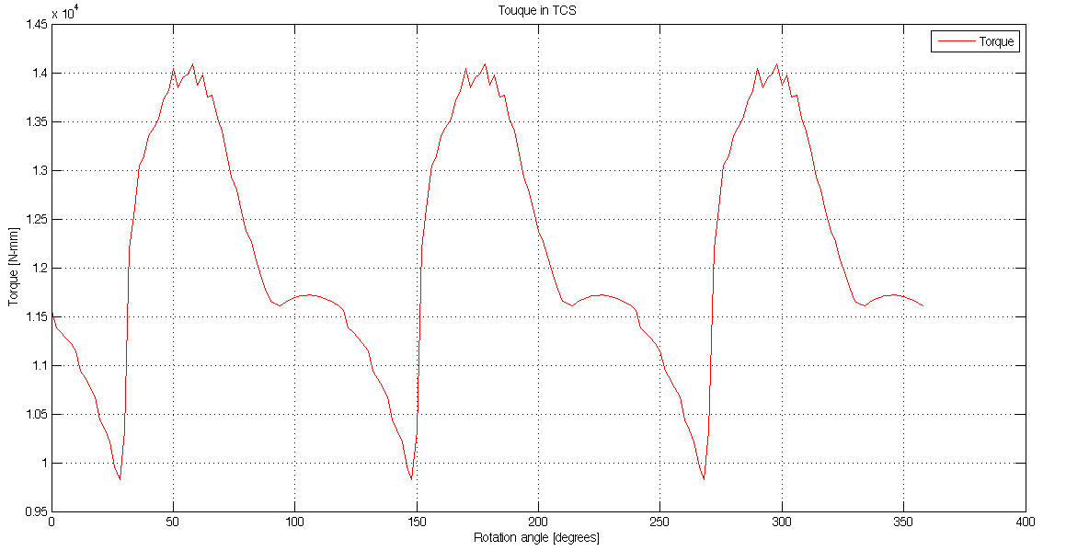
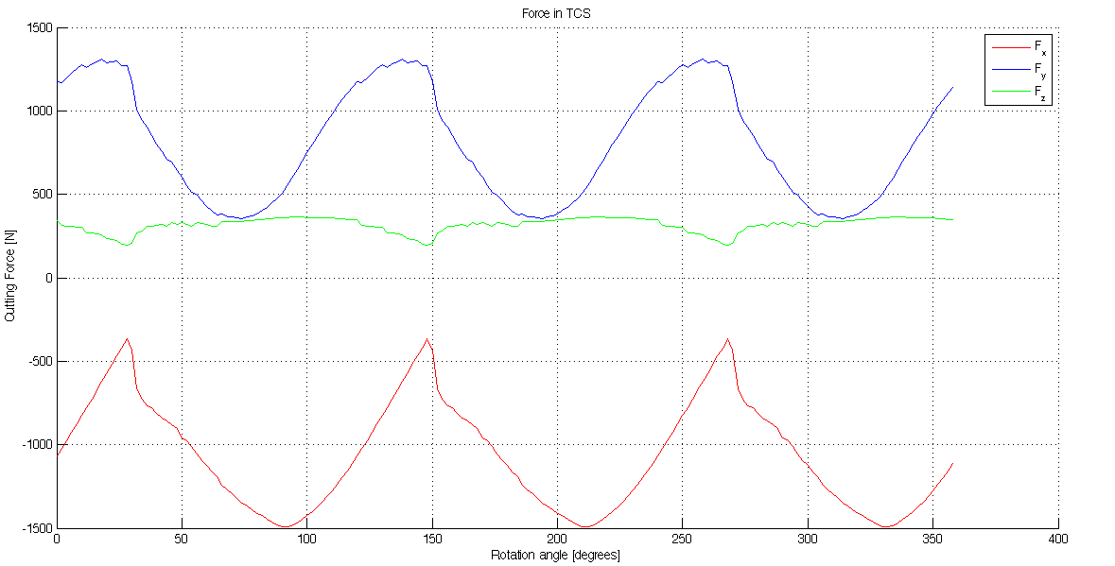
CASE 3: Inputs parameters: Diameter, D = 20mm Helix angle, i₀ = 30⁰ Rake angle, $α$ = 0⁰ Number of flukes, N_{f} = 3 Spindle speed, n=500 rpm Table feed, S_{t} = 100 mm/min Depth of cut = 10mm Lead angle = 20⁰ Tilt angle = 10⁰
Reason for abrupt plot

Slide 27
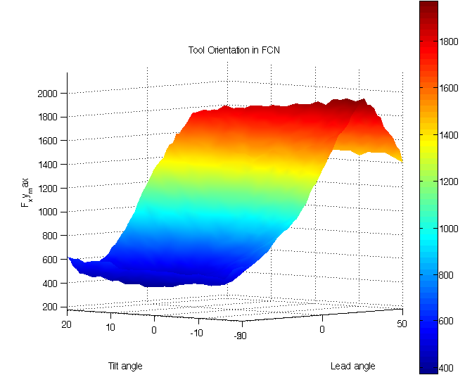
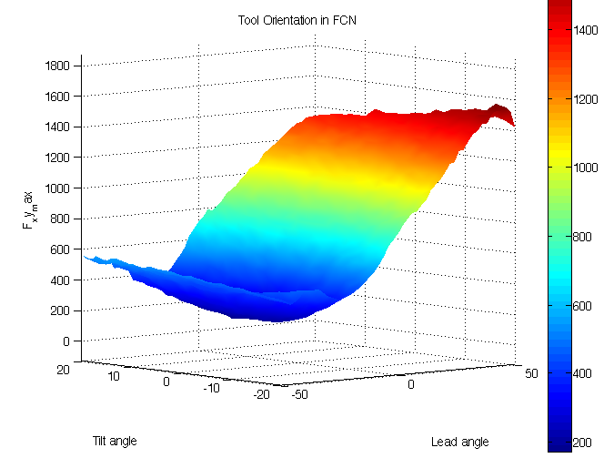
Determining Lead and Tilt Angles
As we increase the depth of cut, the lead and tilt angles also need to be increased (magnitude) to get the minimum value of Fxy_max
Depth of cut = 2.5mm
Lead and tilt angles for minimum force on
the cutting tool are -20⁰ and 4⁰ respectively.
Depth of cut = 5mm
Lead and tilt angles for minimum force on
the cutting tool are -34⁰ and 8⁰ respectively.

Slide 28
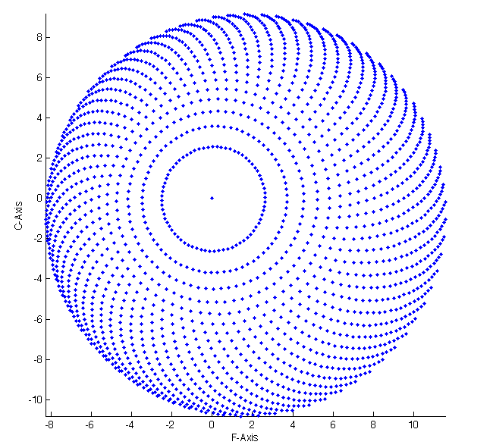
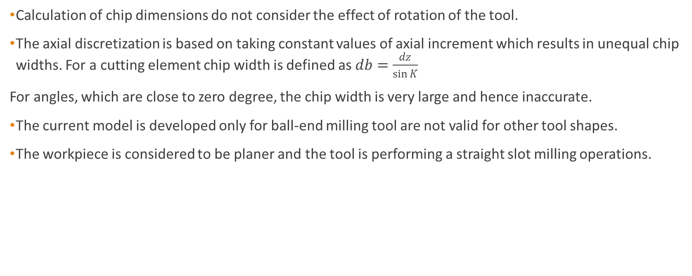
SHORTCOMINGS OF THE CURRENT MODEL
Calculation of chip dimensions do not consider the effect of rotation of the tool.
The axial discretization is based on taking constant values of axial increment which results in unequal chip widths. For a cutting element chip width is defined as $db=\frac{dz}{\sin{K}}$
For angles, which are close to zero degree, the chip width is very large and hence inaccurate.
The current model is developed only for ball-end milling tool are not valid for other tool shapes.
The workpiece is considered to be planer and the tool is performing a straight slot milling operations.

Slide 29
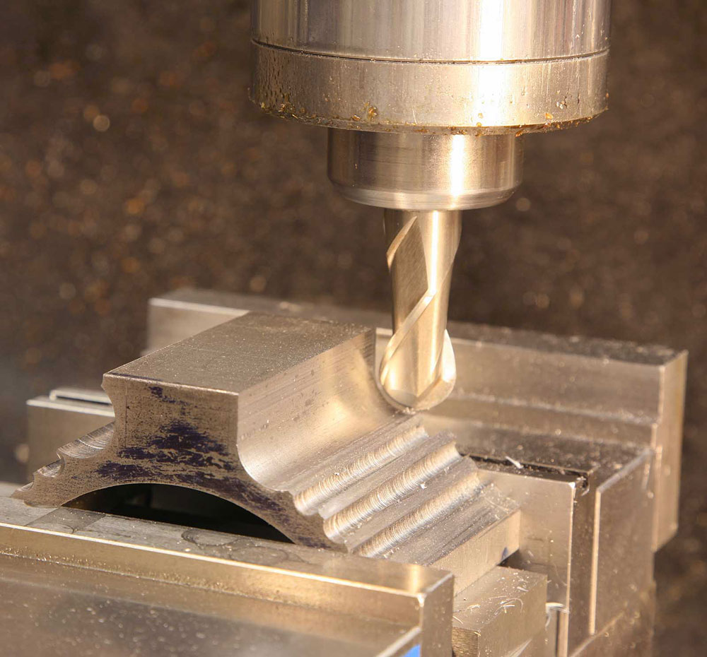
CONCLUSION AND PLAN FOR PHASE II
http://www.wilmotyeh.com/me/images/fullsize/IMG_9706a.JPG

Slide 30
CONCLUSION AND PLAN FOR PHASE II
The simulated results are consistent with the results in published literature. The lead and the tilt angles for the minimization of the cutting forces are predicted using the model.
The model can also be used to predict other machining parameters for the optimization of the cutting process such as precision, cutting depth, feed rate and time required to finish the job.
Future aspects of the project are as follows:
Extension of the model from flat workpiece surface to edge and corner surfaces. Results can be achieved for both types of edge surfaces (Inner and outer edge surfaces) and corner surfaces (inner, outer and combination of both).
Extension of the model to incorporate other tool geometries.
Experimental validation of the data. Current model has been benchmarked against published literature data.
Development of Orthogonal Cutting Data (OCD) for other materials based on experimental results

Slide 31
REFERENCES
1) E. Ozturk, T. Tunc and E. Budak, "INVESTIGATION OF LEAD AND TILT ANGLES EFFECT IN 5-AXIBALL-END MILLING PROCESSES," International journal of machine tools and manufacture, pp. 1053-1062, 2009.
2) E. Budak and E. Ozturk, "Modeling of 5-axis Milling Processes" 2007.
3) P. Budak and Y. Altintas, "Prediction of Milling Force Coefficients From Orthogonal Cutting Data," Department of Mechanical Engineering, The University of British Columbia, Canada.
4) P. Lee and Y. Altintas, , "PREDICTION OF BALL END MILLING FORCES FROM ORTHOGONAL CUTTING DATA," International journal of machine tools and manufacture, pp. 1059-1072, 1996.
5) B. Li, H. Yujin, X. Wang and C. Li, "AN ANALYTICAL MODEL OF OBLIQUE CUTTING WITH APPLICATION TO END MILLING," Machining Science and Technology, An International Journal, pp. 453-484, 2011.
6) Y. ALTINTAS, "METAL CUTTING MECHANICS, MACHINE TOOL VIBRATIONS, AND CNC DESIGN," in MANUFACTURING AUTOMATION Second edition, p. Chapter 2.

Slide 32
THANK YOU

